Slide 1
Chapter 17
Understanding Object Serialization

Slide 2
Objectives
Examining the related topics of object serialization

Slide 3
Content
Understanding Object Serialization
Configuring objects for Serialization
Choosing a Serialization formatter
Serializing objects Using the BinaryFormatter
Serializing objects Using the SoapFormatter
Serializing objects Using the XmlSerializer.
Persisting collections of objects

Slide 4
Understanding Object Serialization
The term serialization describes the process of persisting (and possibly transferring) the state of an object to a stream.
The persisted data sequence contains all necessary information needed to reconstruct (or deserialize) the state of the object for use later.
It is trivial to save vast amounts of data (in various formats) with minimal fuss and bother (in comparison with making direct use of the readers/writers found within the System.IO namespace).
Example: provide a way for end users to save their preferences to a GUI-based desktop application.

Slide 5
Understanding Object Serialization
When an object is persisted to a stream, all associated data (base classes, contained objects, etc.) are automatically serialized as well.
A set of interrelated objects is represented using an object graph.
.NET serialization services also allow you to persist an object graph in a variety of formats:
  Compact binary format (previous example)
  A Simple Object Access Protocol (SOAP) or XML format
An object graph can be persisted into:
  Any System.IO.Stream-derived type (previous example)
  A MemoryStream type

Slide 6
Understanding Object Serialization
The role of Object Graphs
  when an object is serialized, the CLR will account for all related objects.
  The set of related objects is collectively referred to as an object graph.
  Object graphs provide a simple way to document how a set of objects refer to each other and do not necessarily map to classic OO relationships
  Each object in an object graph is assigned a unique numerical value.
  Once all objects have been assigned a numerical value, the object graph can record each object’s set of dependencies.

Slide 7
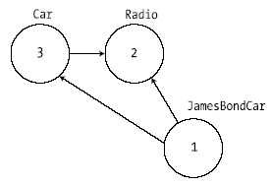
Understanding Object Serialization
The role of Object Graphs

Slide 8
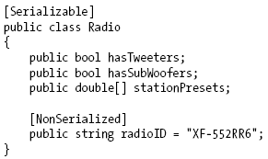
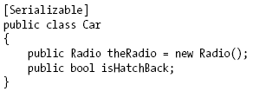
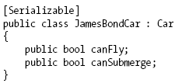
Configuring objects for Serialization
Decorate each related class with the [Serializable] attribute to make an object available to .NET serialization services.
Mark fields with [NonSerialized] if they should not (or perhaps cannot) participate in the serialization scheme.
The [Serializable] attribute cannot be inherited.

Slide 9
Configuring objects for Serialization
Public Fields, Private Fields, and Public Properties
  BinaryFormatter serialize all serializable fields of a type, regardless of whether they are public fields, private fields, or private fields exposed through type properties.
  XmlSerializer or SoapFormatter only serialize public pieces of field data or private data exposed through public properties.
  [NonSerialized]

Slide 10
Choosing a Serialization formatter
BinaryFormatter serializes object graph to a stream using a compact binary format.
SoapFormatter represents graph as a SOAP message.
XmlSerializer persists an object graph as an XML document,

Slide 11
Choosing a Serialization formatter
The IFormatter and IRemotingFormatting Interfaces
Type Fidelity Among the Formatters

Slide 12
Serializing objects using the BinaryFormatter
Serialize(): Persists an object graph to a specified stream as a sequence of bytes
Deserialize(): Converts a persisted sequence of bytes to an object graph

Slide 13
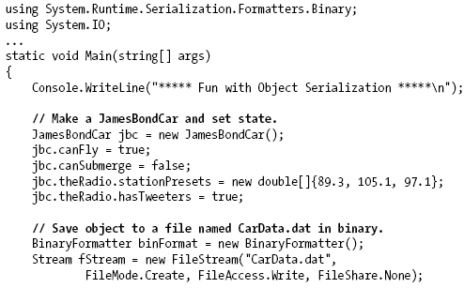

Serializing objects using the BinaryFormatter
Example:

Slide 14
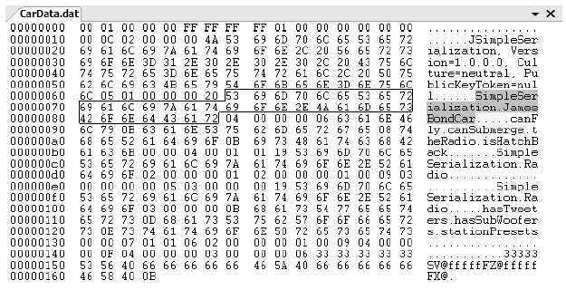
Serializing objects using the BinaryFormatter
JamesBondCar serialized using a BinaryFormatter

Slide 15
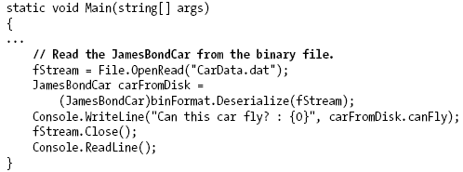
Serializing objects using the BinaryFormatter
Deserializing Objects Using the BinaryFormatter
Example:

Slide 16
Serializing objects using the SoapFormatter
The SoapFormatter will persist an object graph into a SOAP message, which makes this formatter a solid choice when you wish to distribute objects remotely using the HTTP protocol.
SOAP defines a standard process in which methods may be invoked in a platform- and OS-neutral manner (discussion of XML web services).

Slide 17
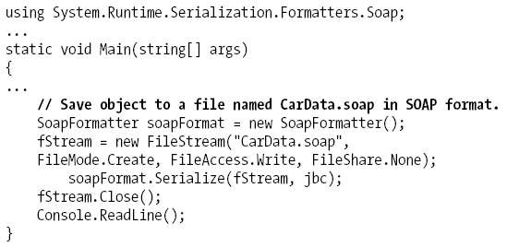
Serializing objects using the SoapFormatter

Slide 18
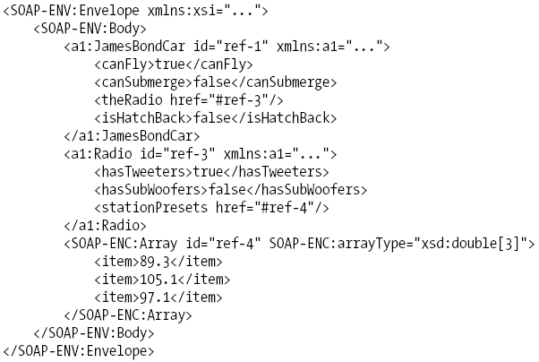
Serializing objects using the SoapFormatter
XML elements, which mark the stateful values of the current JamesBondCar, as well as the relationship between the objects can be located in the graph via the #ref tokens.

Slide 19
Serializing objects using the XmlSerializer
XmlSerializer, which can be used to persist the state of a given object as pure XML, as opposed to XML data wrapped within a SOAP message.

Slide 20
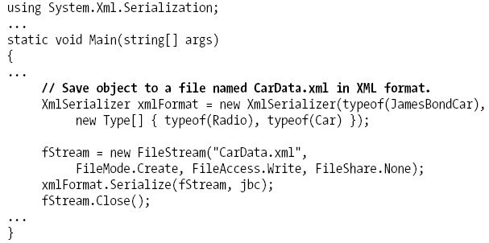
Serializing objects using the XmlSerializer

Slide 21
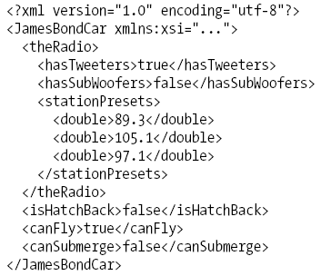
Serializing objects using the XmlSerializer
Content of CarData.xml file:

Slide 22
Serializing objects using the XmlSerializer
Note The XmlSerializer demands that all serialized types in the object graph support a default constructor
  If this is not the case, you will receive an InvalidOperationException at runtime.

Slide 23
Persisting collections of objects
The Serialize()method of the IFormatter interface does not provide a way to specify an arbitrary number of objects (only a single System.Object)
The return value of Deserialize() is, again, a single System.Object.

Slide 24
Q & A

